Slide 1
CSE 5051 DESIGN PATTERNS
Mert BAYRAKTAR
202151075008

Slide 2
Tourist Agency System
Customer Information Panel (Panel 1):
Allows users to input their name, phone number, age, job, and select between individual or group trip.
Provides a dropdown menu for selecting the user's job.
Special Packages Panel (Panel 2):
Offers three different packages (Package 1, Package 2, and Package 3) as radio buttons for users to choose from.
Each package corresponds to a different set of services and prices.
Individual Trip Customization Panel (Panel 3):
Allows users to customize their individual trip by selecting transportation (Taxi or Bus), activity (Sea Cruise or Sky Diving), and accommodation (Hotel or Motel).
Provides radio buttons for selecting luxury taxi, luxury hotel, or adventure sea cruise.
These choices affect the total price of the trip.
Payment Methods Panel (Panel 4):
Allows users to choose between two payment methods: PayPal and Credit Card.
The selected payment method is stored for later use.
Service Details Panel (Panel 5):
Displays detailed information about the selected services, including transportation, activity, and accommodation.
This information is updated based on the user's selections.
Agency Control Panel (Panel 6):
Offers buttons to start a live chat with customer support, make a reservation, and search for a customer by phone number.
When making a reservation, customer information, selected services, and payment method are processed and saved.
Reservations Details Panel (Panel 7):
Displays reservation details for customers based on their phone number.
Information is loaded from a file containing reservations.
Chat Panel (Panel 8):
Provides a chat interface with separate text areas for user and customer support messages.
Users can send messages as either "User" or "Support," and messages are displayed accordingly.

Slide 3
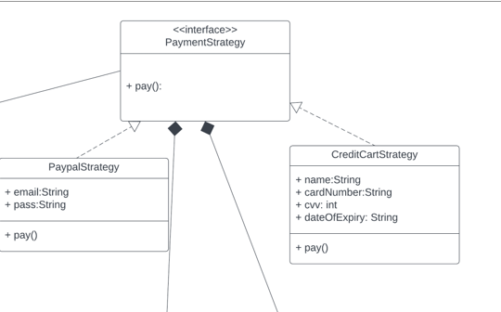
Strategy Pattern
PaymentStrategy Interface:
The PaymentStrategy interface defines a contract for payment strategies. It declares a single method pay(int amount) for processing payments.
PayPalStrategy Class:
The PayPalStrategy class implements the PaymentStrategy interface.
It has instance variables email and pass to store the user's PayPal email and password.
CreditCardStrategy Class:
The CreditCardStrategy class also implements the PaymentStrategy interface.
It has instance variables name, cardNumber, cvv, and dateOfExpiry to store credit card details.
Notes:
the Strategy Pattern is used to implement two different payment methods (PayPal and Credit Card) in a flexible and interchangeable way. The Strategy Pattern allows you to define a family of algorithms, encapsulate each one, and make them interchangeable.

Slide 4
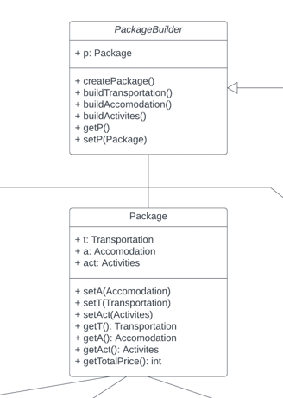
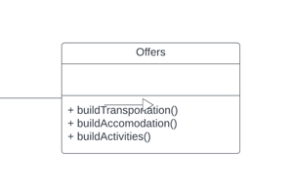
Builder Pattern
The Builder Pattern is a creational design pattern that separates the construction of a complex object from its representation, allowing you to create different variations of an object step by step.
Notes:
Package Class:
The Package class represents a package that can include transportation (t), accommodation (a), and activities (act).
It provides methods to set these components and calculate the total price of the package (getTotalPricee()).
PackageBuilder Abstract Class:
The PackageBuilder abstract class serves as the builder for creating packages.
It contains an instance variable p of type Package, which is the package being constructed.
The createPackage() method initializes a new Package object and starts the construction process.
The abstract methods buildTransportation(), buildAccommodation(), and buildActivities() are declared. Subclasses will implement these methods to specify the details of each component of the package.
The getP() method allows access to the constructed package.
The setP() method allows setting an existing package if needed (though it's not used in this example).
Offer1 Class (Concrete Builder):
The Offer1 class is a concrete subclass of PackageBuilder.
It provides a specific implementation for building a package of type Offer1. In this case, it sets the transportation to a Taxi, accommodation to a Hotel, and activities to SkyDiving.
The createPackage() method initializes a new Package object and specifies the components for an Offer1 package using the buildTransportation(), buildAccommodation(), and buildActivities() methods.
We need to create complex objects (packages) with multiple components, and these components can vary from one package to another.
For example, one package might include a taxi, a hotel stay, and skydiving, while another package could have a different combination of transportation, accommodation, and activities.

Slide 5
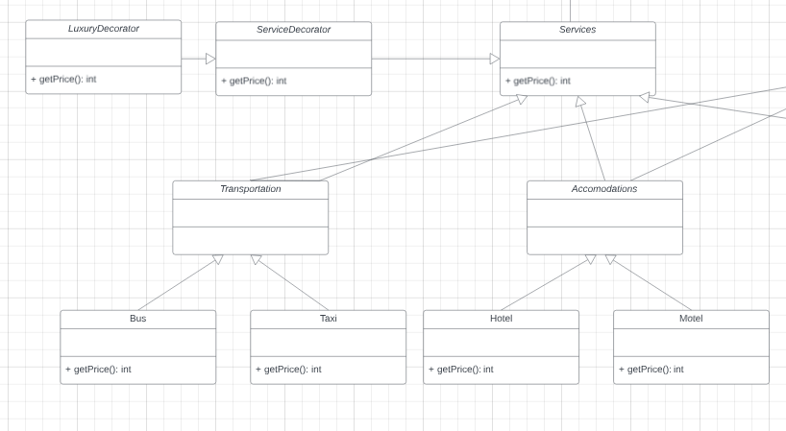
Decorator Pattern
Customers can select various services as individuals.
After selecting services, the decorator pattern allows us to add Luxury features dynamically.
Notes:
the decorator pattern is used to dynamically add or modify behavior and features to objects of a particular class without altering their code. This pattern allows us to extend the functionality of classes in a flexible and reusable way by creating a set of decorator classes that wrap around the core class.

Slide 6
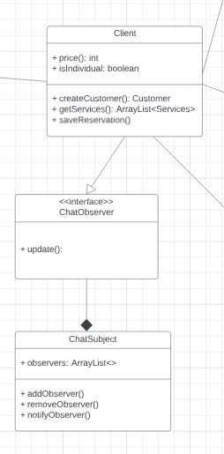
Observer Pattern
The Observer Pattern is used to enable chat communication between users and support agents, with the ChatSubject managing observers and notifying them of new messages.
Notes:
The Observer Pattern is a behavioral design pattern that defines a one-to-many dependency between objects, so that when one object (the subject) changes its state, all its dependents (observers) are notified and updated automatically. In the provided code, the Observer Pattern is implemented to facilitate communication between different components of the application, specifically for handling chat messages between users and customer support.

Slide 7
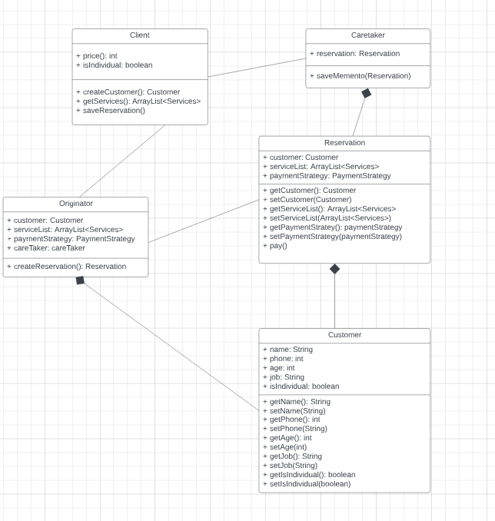
Optional: Memento Pattern
Notes:
the Memento design pattern is used to capture and externalize the internal state of the Reservation objects so that they can be stored and restored at a later time.
CareTaker Class: The CareTaker class is responsible for managing and saving mementos (in this case, reservations) of customers and their services.
Customer Class: The Customer class represents customer information and preferences
Originator Class: The Originator class creates and saves reservations. It takes a Customer object, a list of Services, a CareTaker object, and a PaymentStrategy object as parameters during initialization. The createReservation method creates a new Reservation object using the provided customer, services, and payment strategy. It then asks the CareTaker to save this reservation, effectively capturing the current state.
Reservation Class: The Reservation class represents a reservation, which includes a customer, a list of services, and a payment strategy

